Slide 1
Placement of Insect Light Traps

Slide 2
Section 1: The Process

Slide 3
Placement of ILTs: Step 1 Initial survey
Carry out an initial survey to gather information on the site
Start outside of the building
Note the most likely sources of insects – i.e. breeding sites such as dumpsters, drainage, farms etc…
Walk from outside to the inside of the building
Establish the likely entry points for flying insects
Determine the natural path the insects might take as they move through the building
Consider how windows, doors, lighting and air movement might guide insects along.
Grade the areas of the building according to level of risk – low, medium and high.
Define front and back of house areas that need flying insect control equipment
Plan the specific locations for insect light traps
Notes:
Areas of major problems.
Approximate size.
Windows, Door ways & how often it is opened.
Establish fly breeding sites nearby e.g. dairy farms, chicken farms, dumpsters, drainage, farms etc –
Establish areas that are Wet, has high humidity, Glass free, explosion proof areas.
Use UV A meter to establish level of contrasting UV and best area to place the unit.

Slide 4
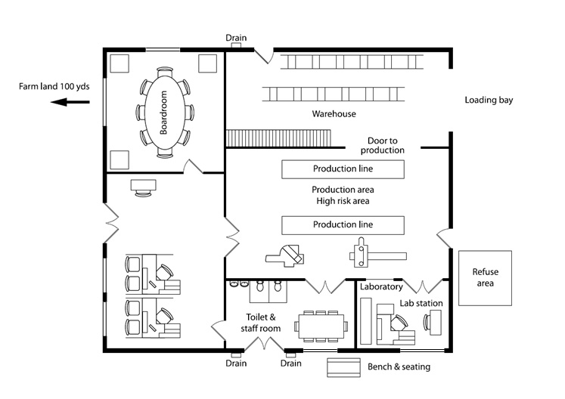
A floor plan is a very useful tool for initial survey
Key Questions to answer:
Likely breeding sites (e.g. near food sources)
Entry points for flying insects
Predict natural path of insects
Define “High”, “Medium” and “Low” risk areas
Define front of house and back of house areas
Approximate size of location(s) (room-by-room)
Consider windows, doorways, lighting (& how often are they used)
Propose insect light trap placement/positioning

Slide 5
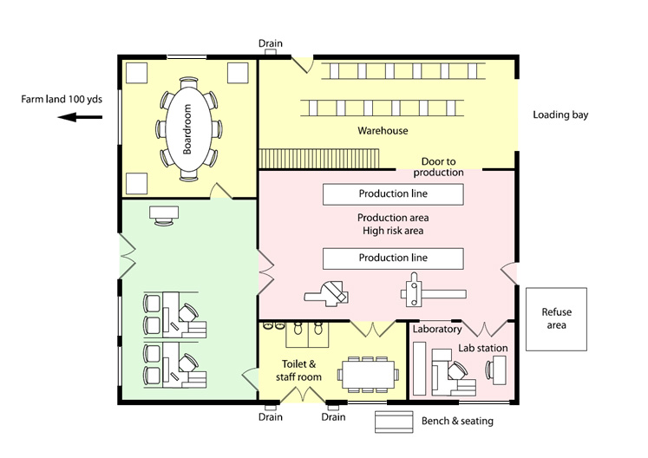
Placement of ILTs
Medium risk area
Identify breeding sites
Identify entry points
Identify and define risk areas
Low risk area
High risk area
Medium risk area

Slide 6
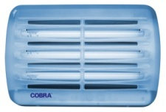
Placement of ILTs General siting guidelines
Place wall mount units where they can be easily serviced
- The units should not be positioned / placed where they can get damaged e.g. in passageways, in the way of maintenance staff and fork lift trucks.
Position the units so that they intercept the flies before entering critical areas.
Position units so that, you draw insects away from the area you are trying to protect.
Do not place units over food preparation, packaging or processing areas
The Genus® Cobra should be wall mounted
copyright Brandenburg UK Limited © 2007

Slide 7
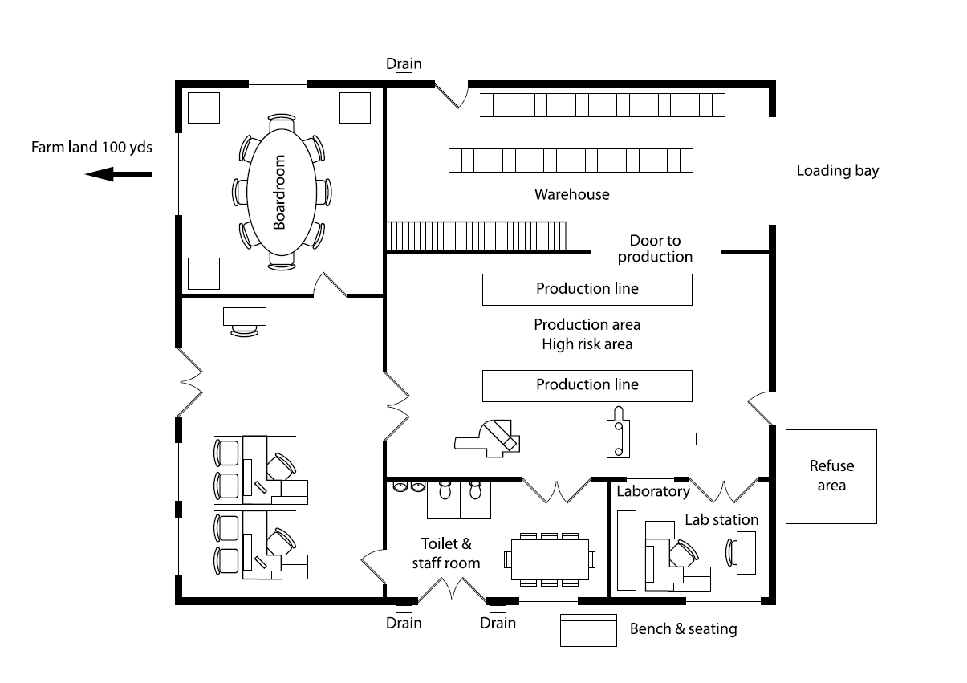
Good locations for ILT’s
Identify suitable ILT locations
Use appropriate unit for front of house or back of house.
Low risk area

Slide 8
Section 2: Example placement in context

Slide 9
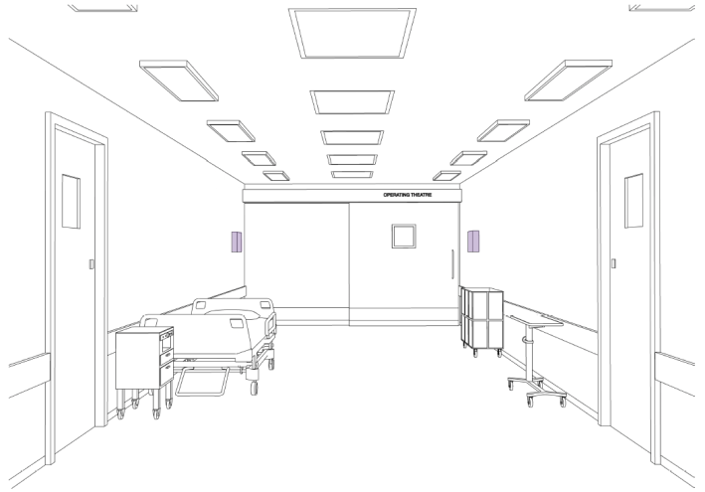
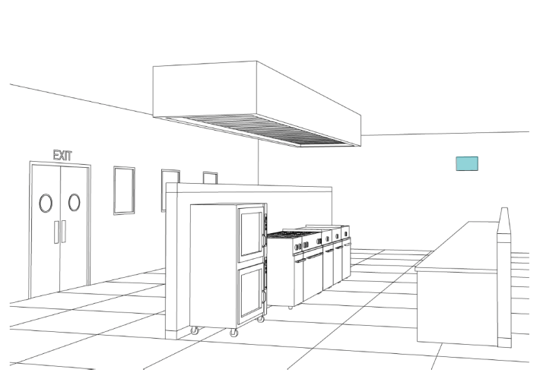
Types of Insect light traps in context
The following slides give a number of examples of locations where ILTs can be placed.
Placement examples include: - Supermarket (various locations) - Café (front of the house) - Health care (public areas) - Commercial Kitchen (back of the house)

Slide 10
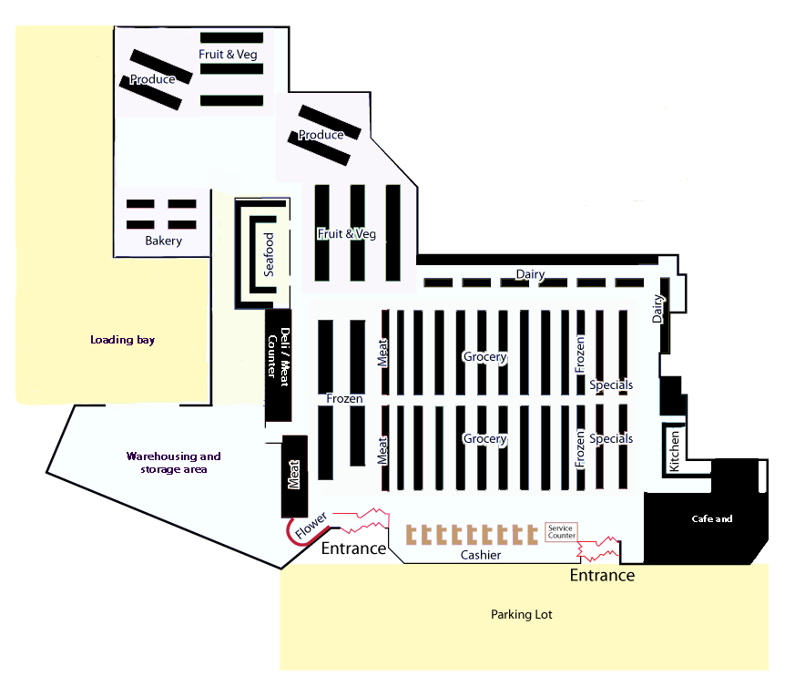
Back of the house control board unit
Front of the house control board unit
High Voltage Grid unit
Super market example
Multiple installations

Slide 11
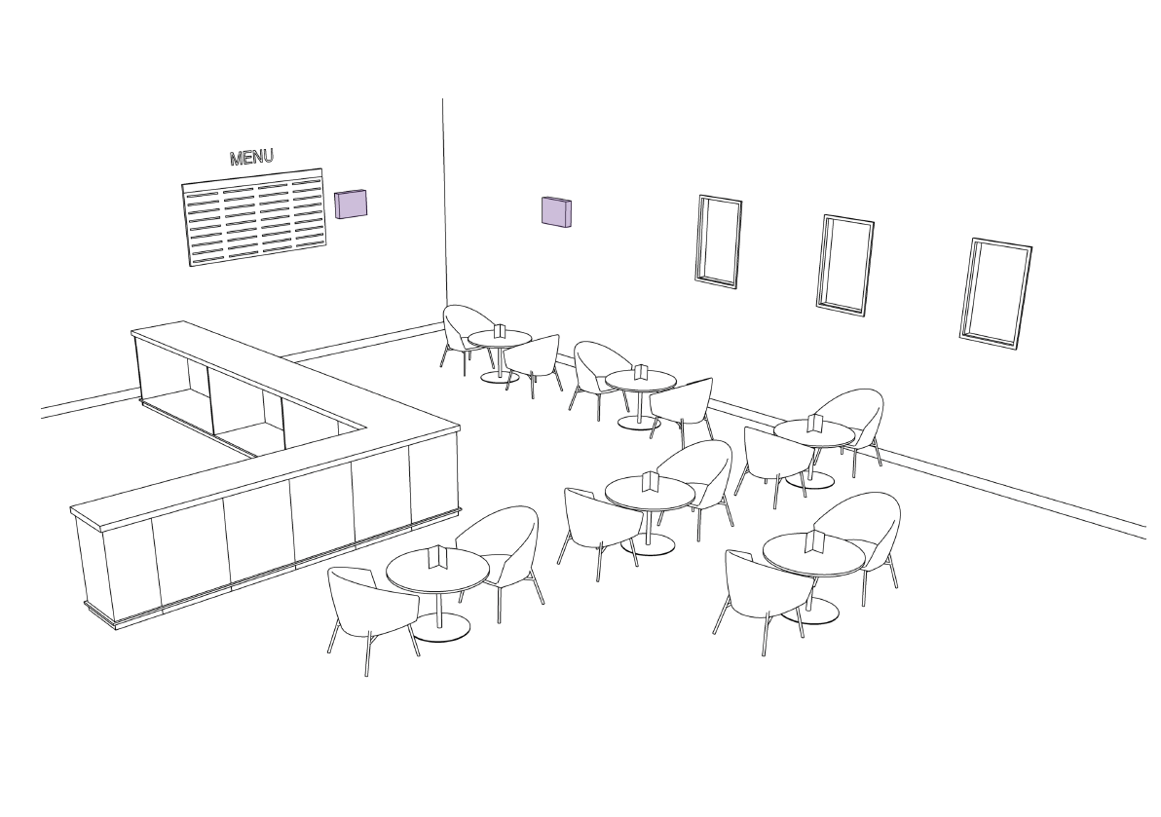
Café example Front of the house
Front of the house units can be used in customer/public areas
- They are designed be discrete, so there is no need to “hide” them.
Because insects are captured fully intact, Brandenburg ILTs may be installed near food preparation or serving lines, but never directly over the food preparation and/or serving areas

Slide 12
Kitchen area Back of the house
Do Install Units:
In intercept paths – capturing insects that enter the kitchen
To draw flying insects away from food preparation areas
Don’t install units:
Next to sources of wind
Next to extreme heat sources
Directly above food preparation areas
Don’t install units:
Adjacent to Natural sources of UVA light
Near doors that open regularly

Slide 13
Hospital facility – example Public areas
Insect light traps are important in health care facilities – install ILTs in corridors and outside of operating theatres
Front of the house units can be used in public areas

Slide 14
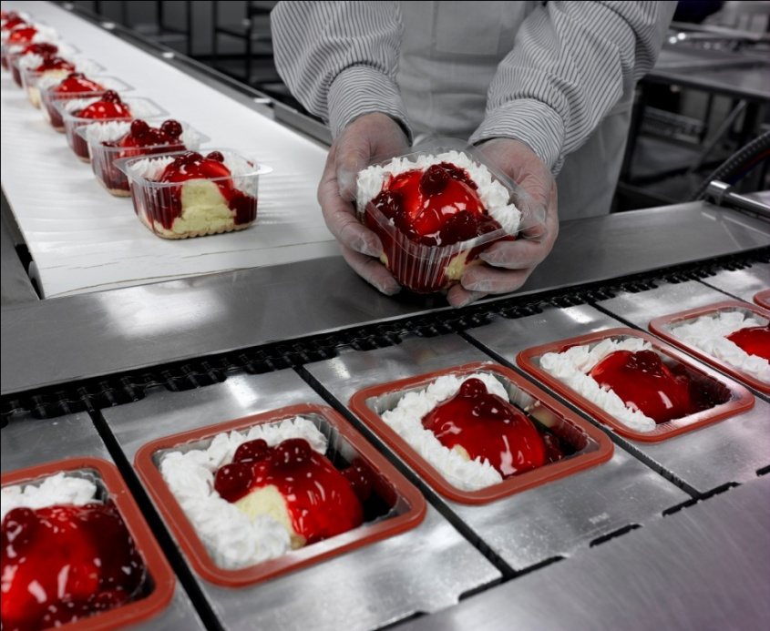
Food Areas Rules of placement of ILTs
Do not use high voltage units in food preparation areas – use control board units only
Do not place units directly over food preparation areas. e.g. above cookers, steam vents etc
Do not place units in near air blowers, air conditioners etc.
In glass free areas use units with Safety/sleeved bulbs.
copyright Brandenburg UK Limited © 2007

